Slide 1
Virtual Reality & hand rehabilitation
By andrea santiago

Slide 2
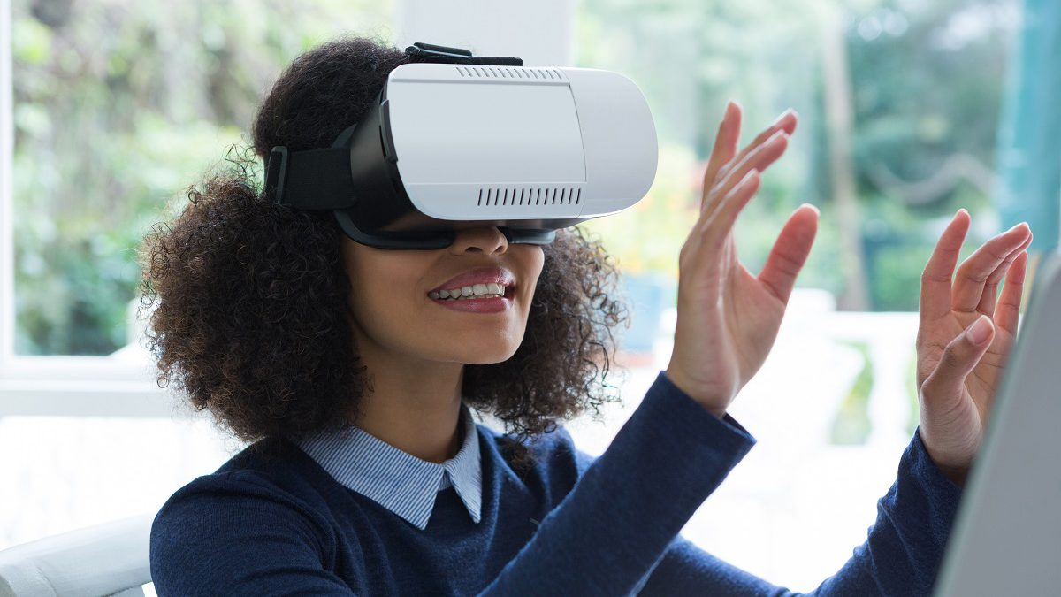
Virtual reality – “a three-dimensional, computer generated environment which can be explored and interacted with, by a person” [1]

Slide 3

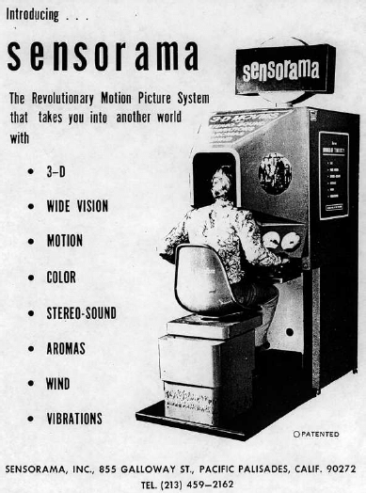
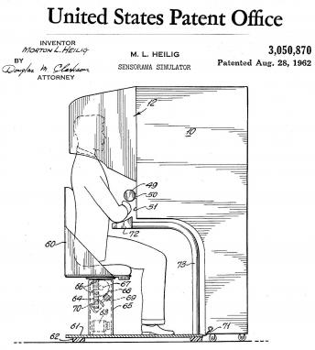
Sensorama, 1957
Morton Heilig, introduced the first virtual simulator
His invention is considered to be one of the earliest functioning efforts in Virtual Reality
Invented in 1957 and patented five years later in 1962

Slide 4
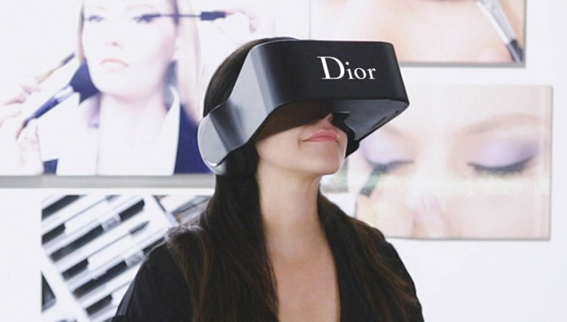
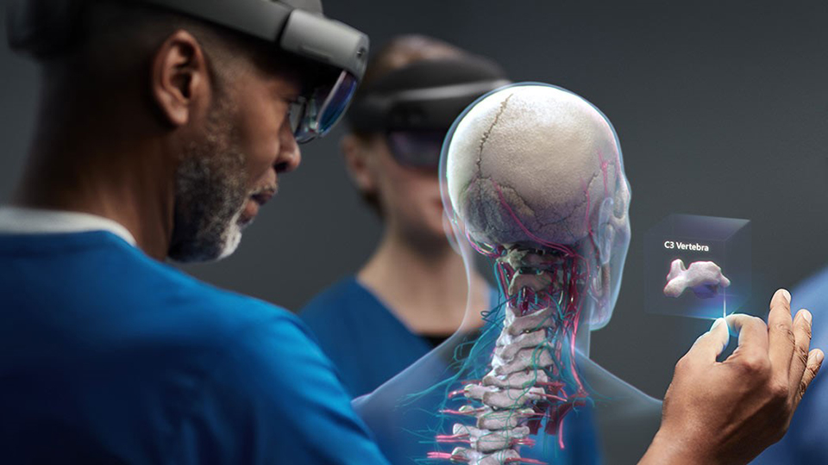
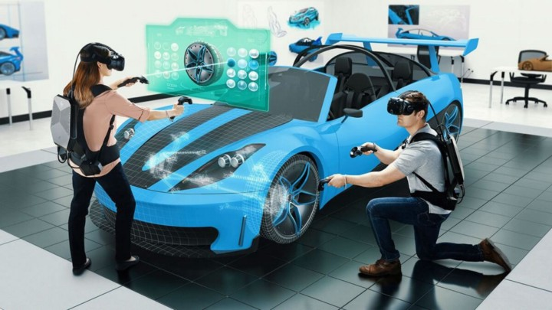

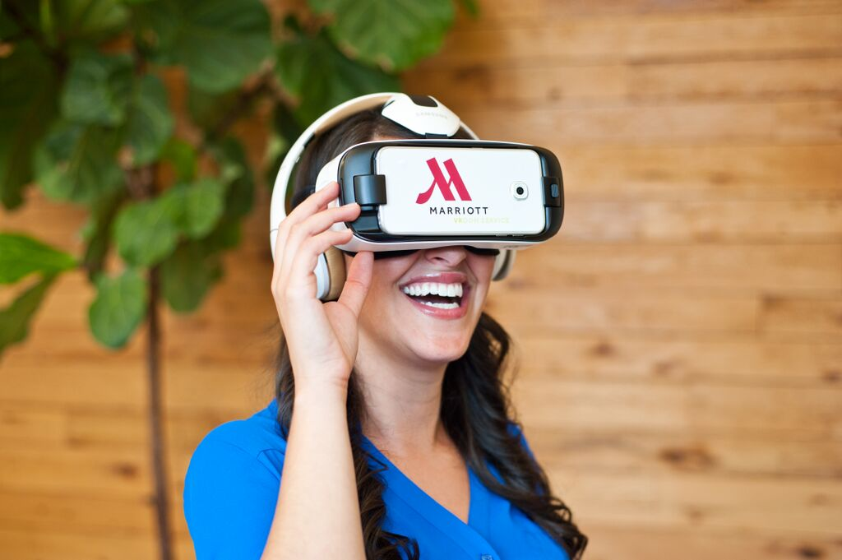
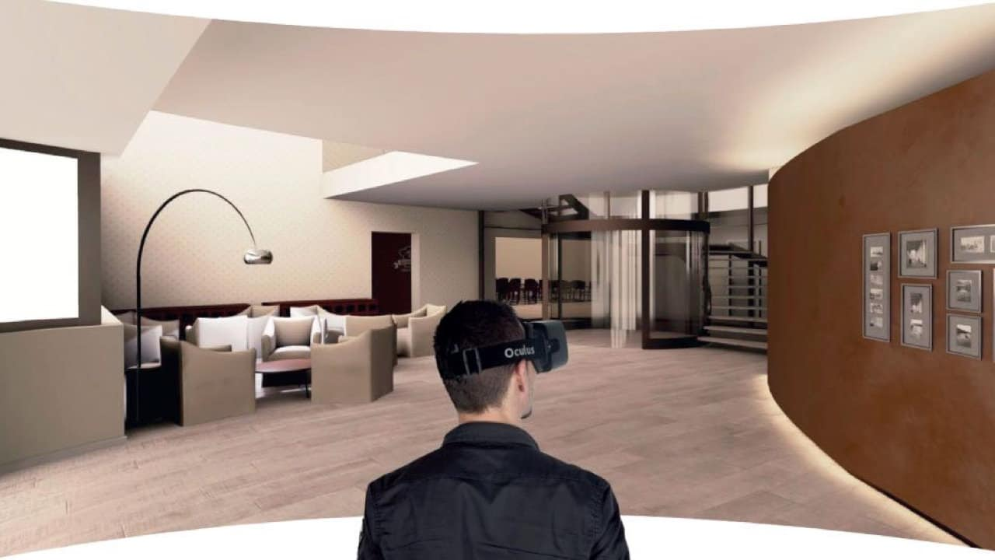
Industries using virtual reality
Fashion/Retail
Automobile
Healthcare
Architecture
Tourism
Real Estate

Slide 5
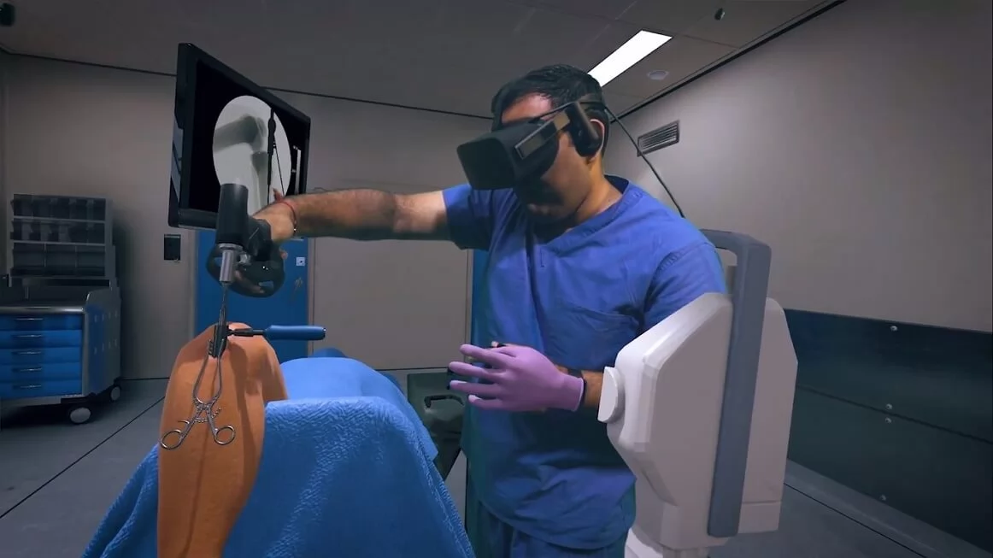
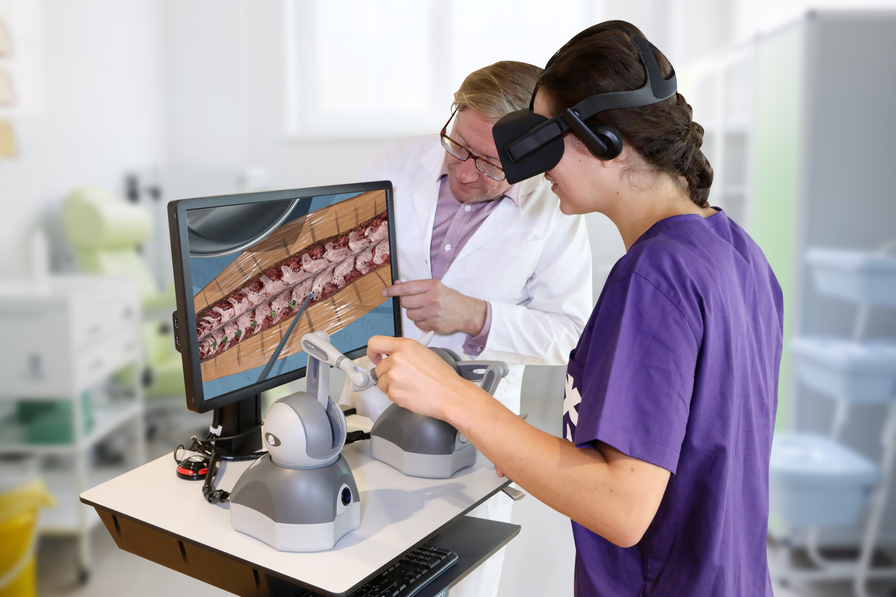
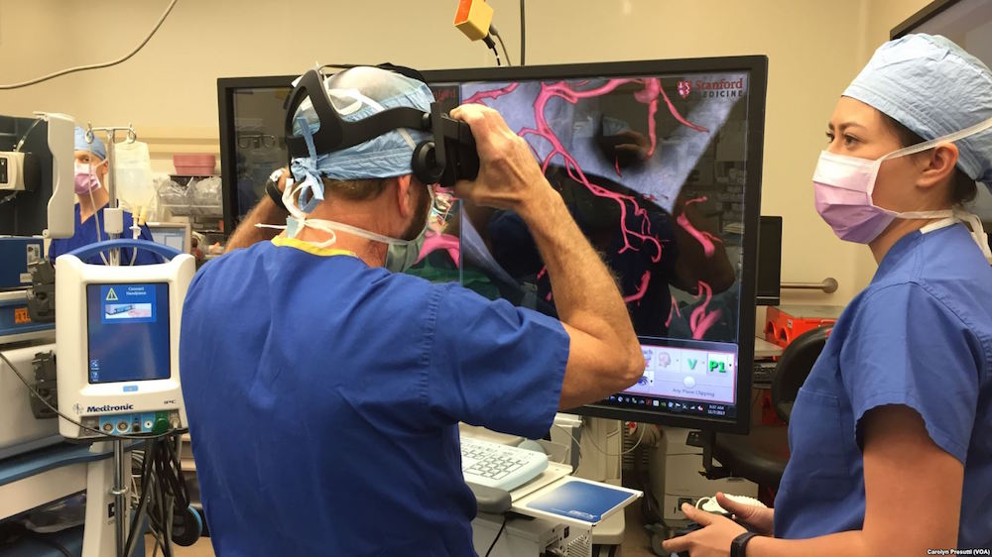
Virtual reality helping the health industry
Helping Students, Nurses, Doctors, Surgeons with virtual reality simulation trainings
It is also helping doctors better understand what their patients are going through with VR simulations
VR is changing Physical Therapy / Hand Rehabilitation

Slide 6
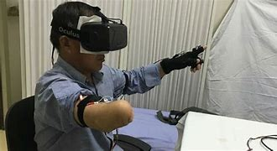
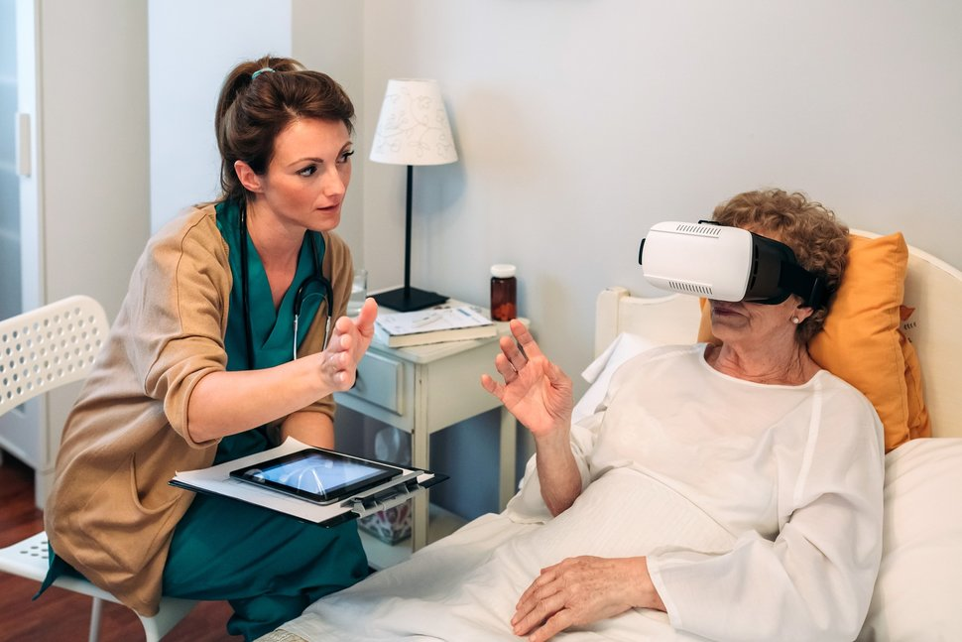
Patients who need hand therapy
Suffered from a stroke
Work injuries
Sport injuries
Surgeries
Arthritis
Peripheral nerve disorders
other neurological conditions

Slide 7
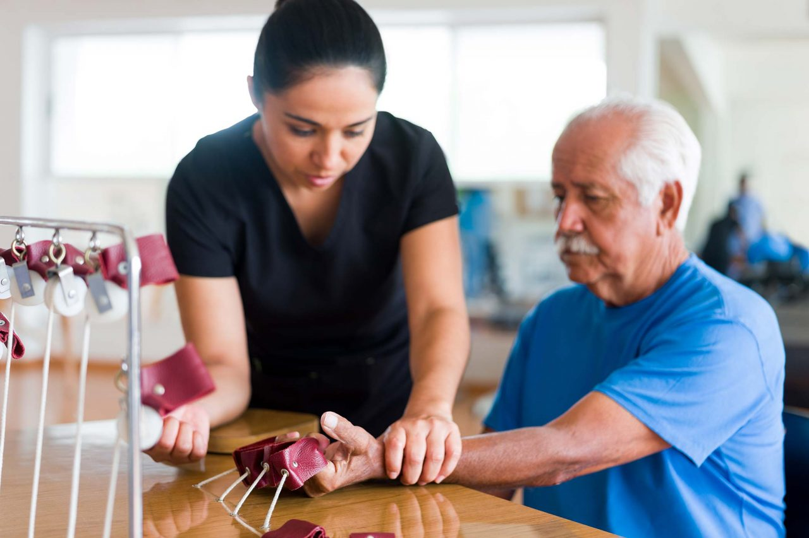
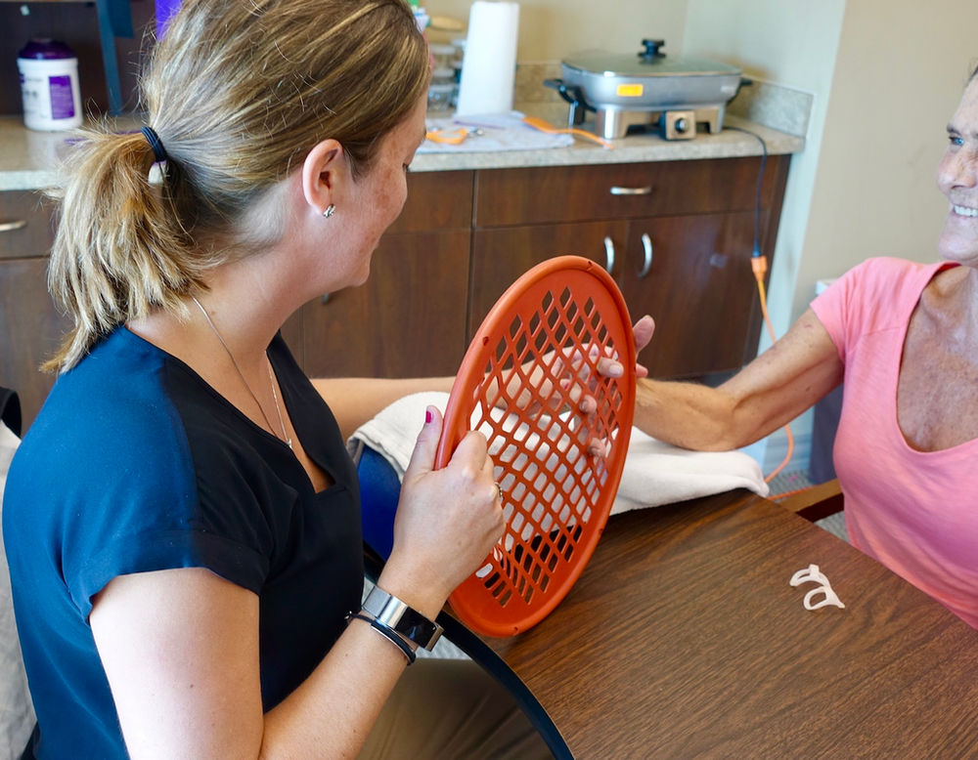
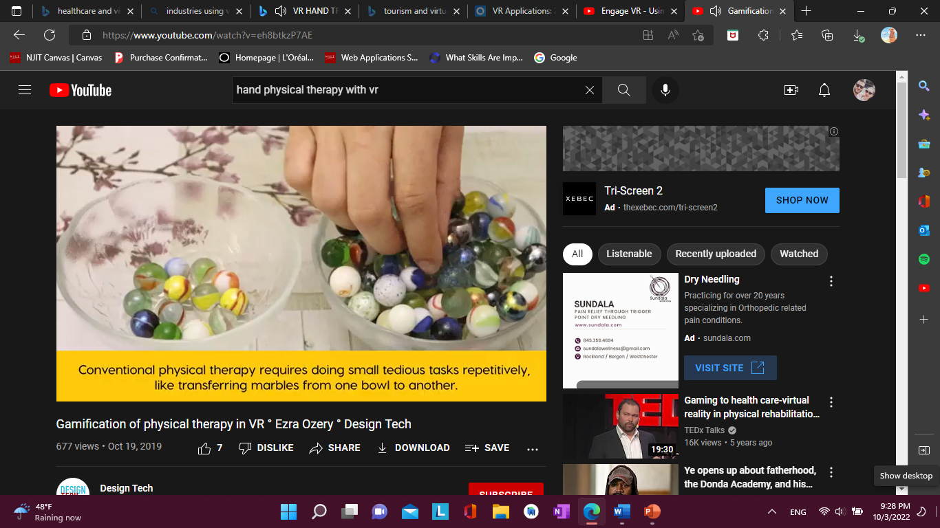
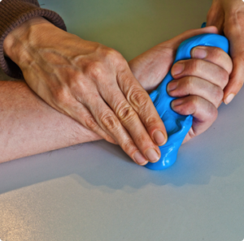
Healthcare: PHYSICAL THERAPY/ hand therapy
Conventional Physical Therapy requires do small tedious tasks repetitively
For many patients, this can be painful and boring

Slide 8
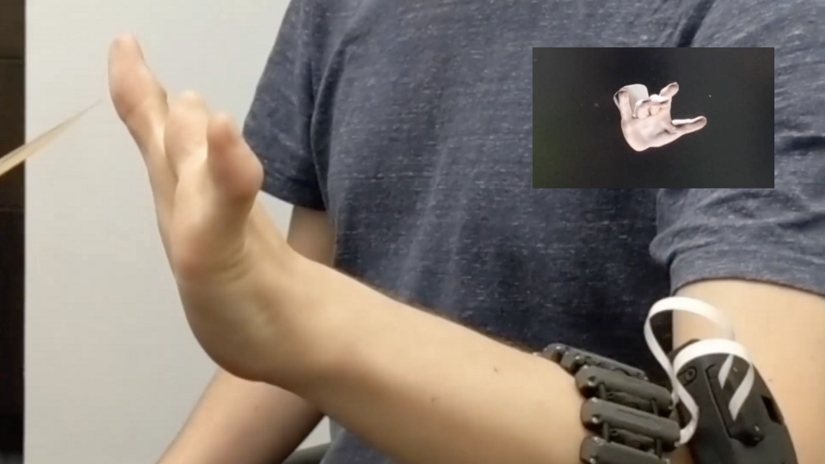
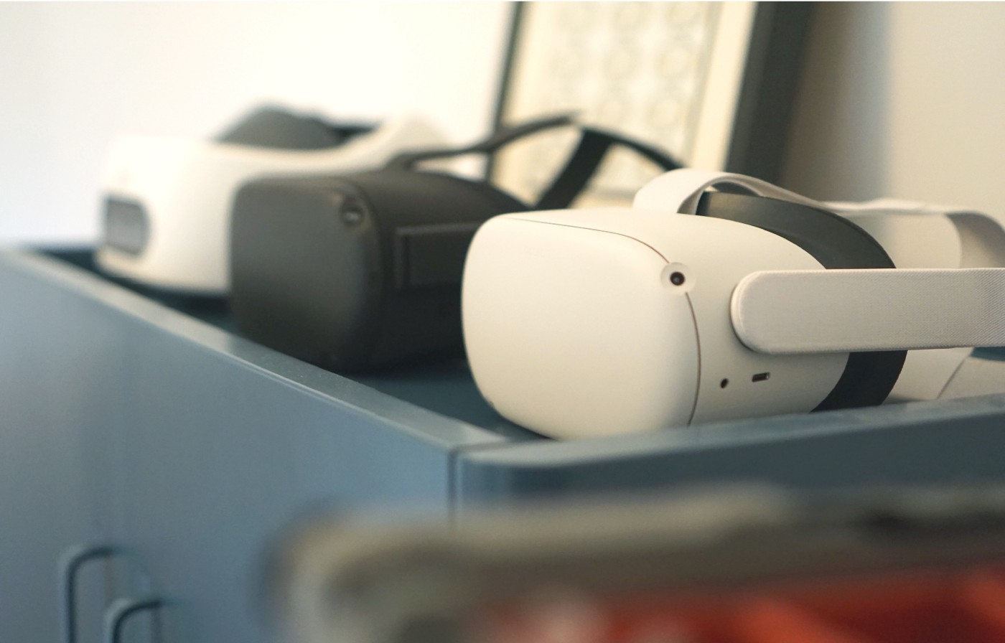
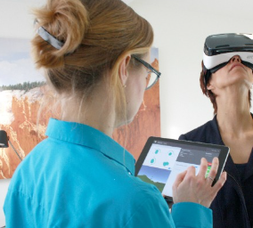
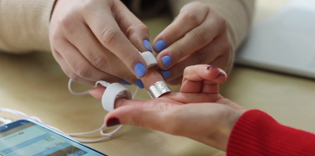
Healthcare: virtual reality hand therapy
A VR Therapy session begins like any other traditional face-to-face therapy session
Use :
Armband to translate/ monitor signals
VR Headset
Laptop computer/ iPad: to monitor your responses, and take notes.
monitors go on two of your fingers
Armband
VR Headset
iPad
Finger monitors

Slide 9
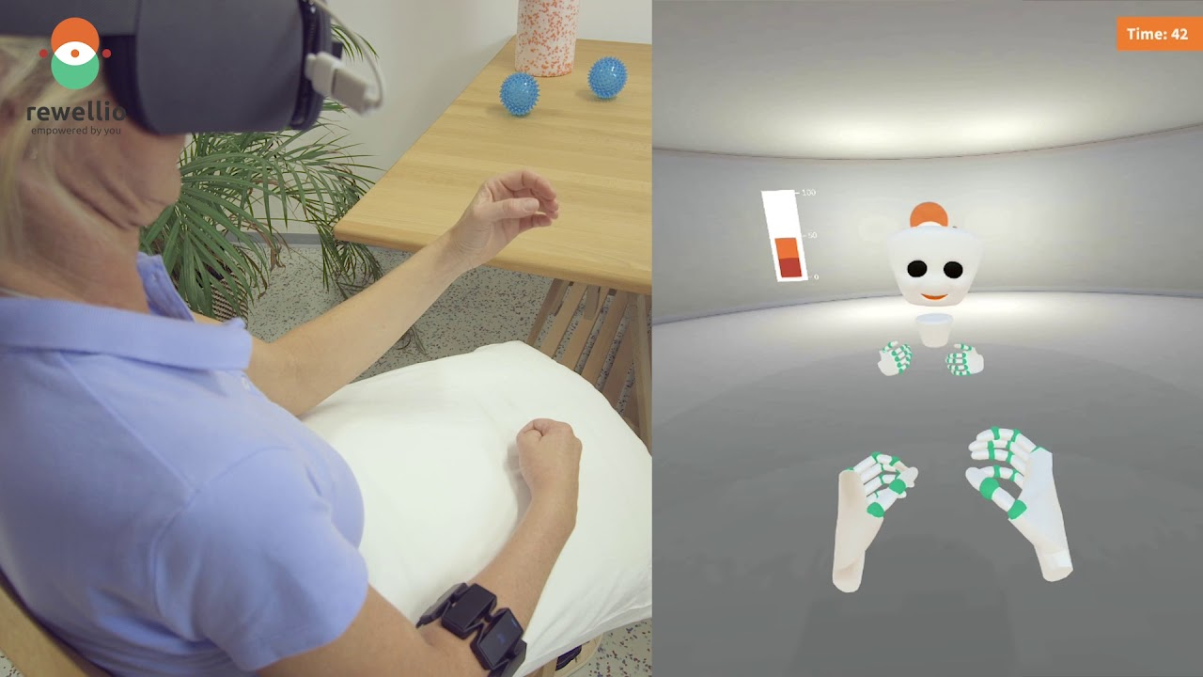
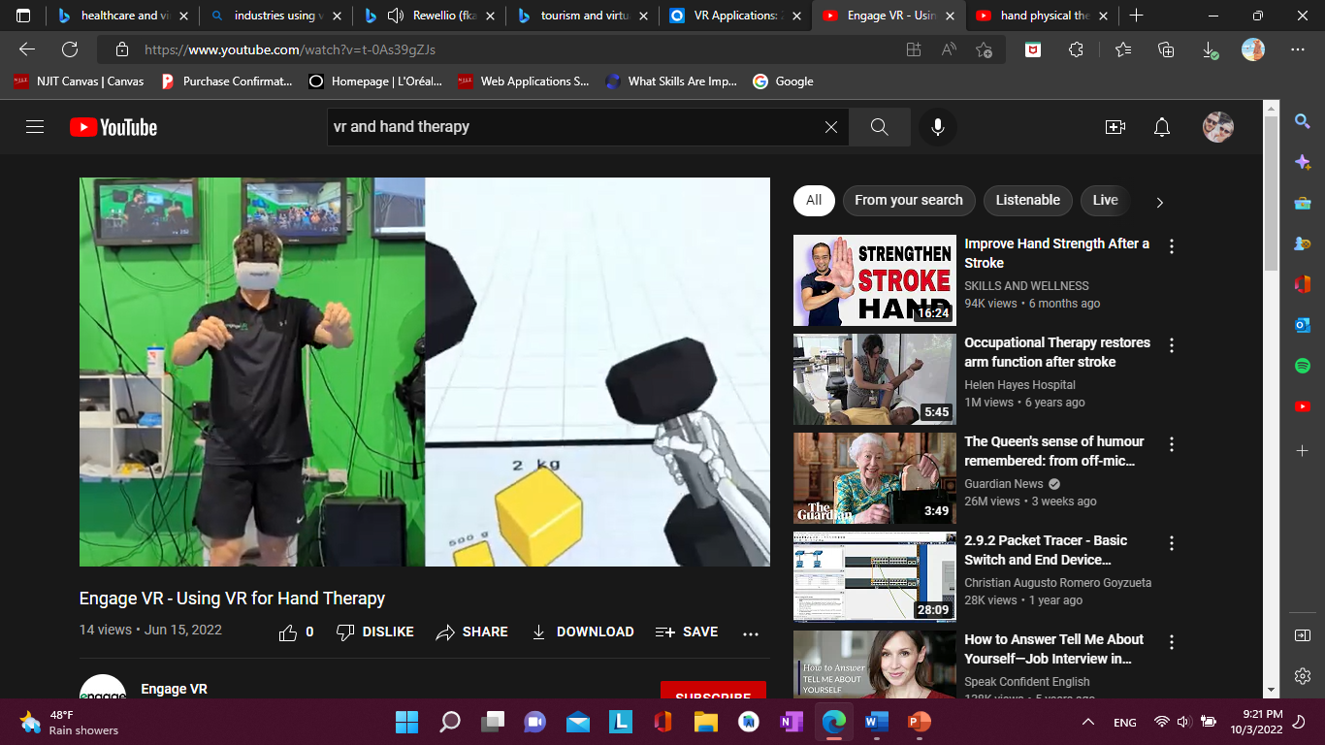
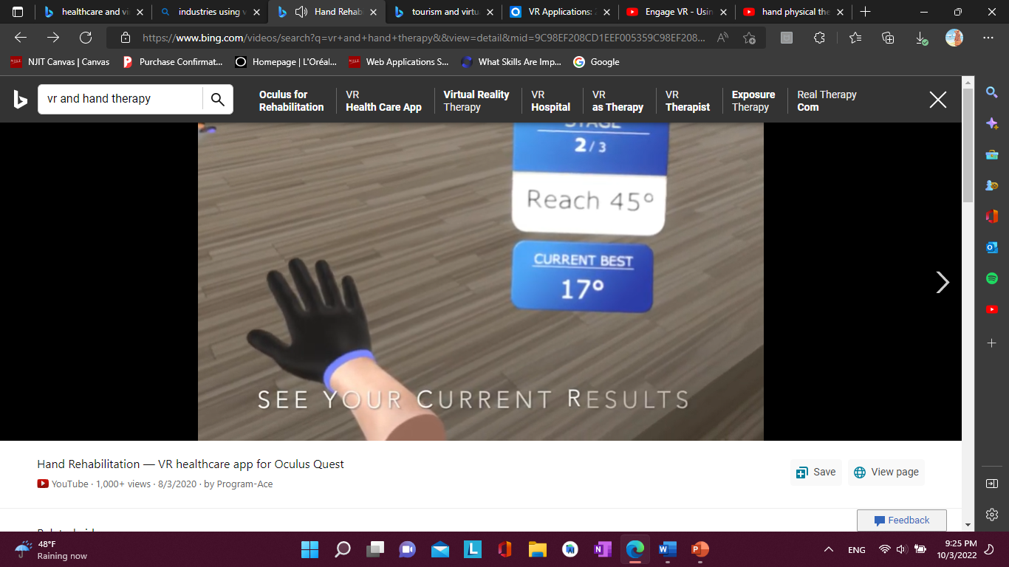
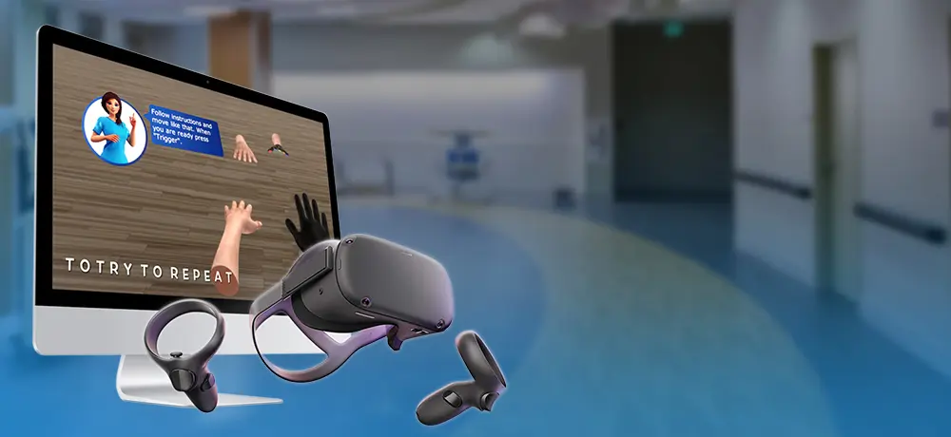
VIRTUAL REALITY AND HAND THERAPY
Gamification- “: the process of adding games or game like elements to something (such as a task) so as to encourage participation” [5]

Slide 10
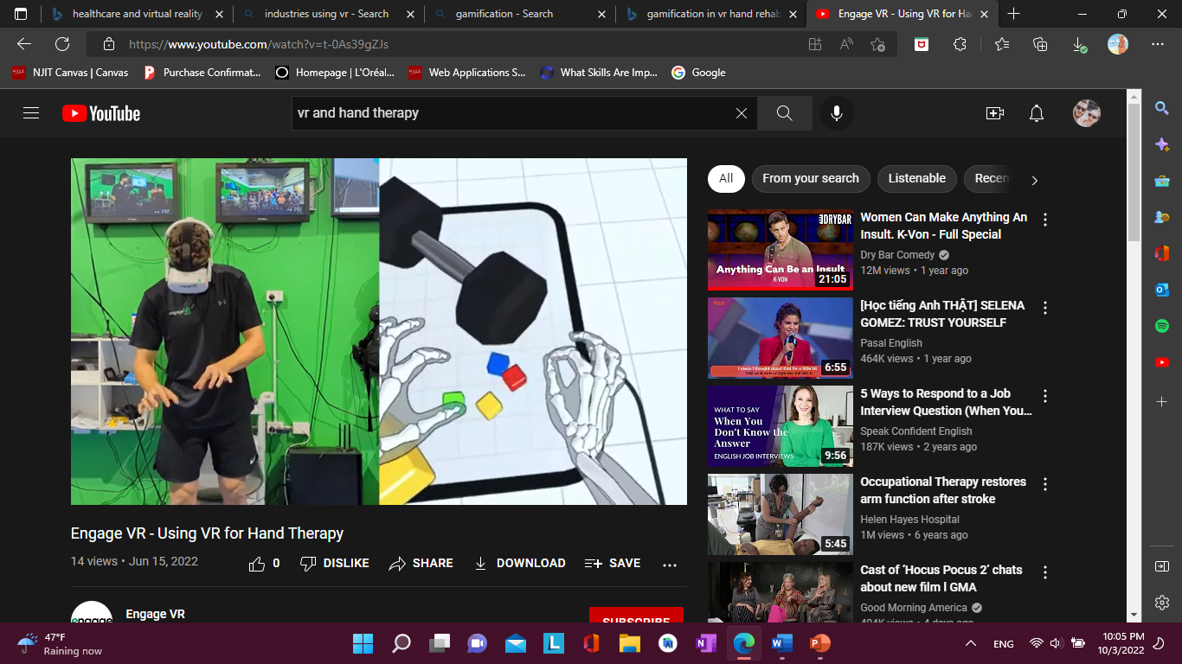
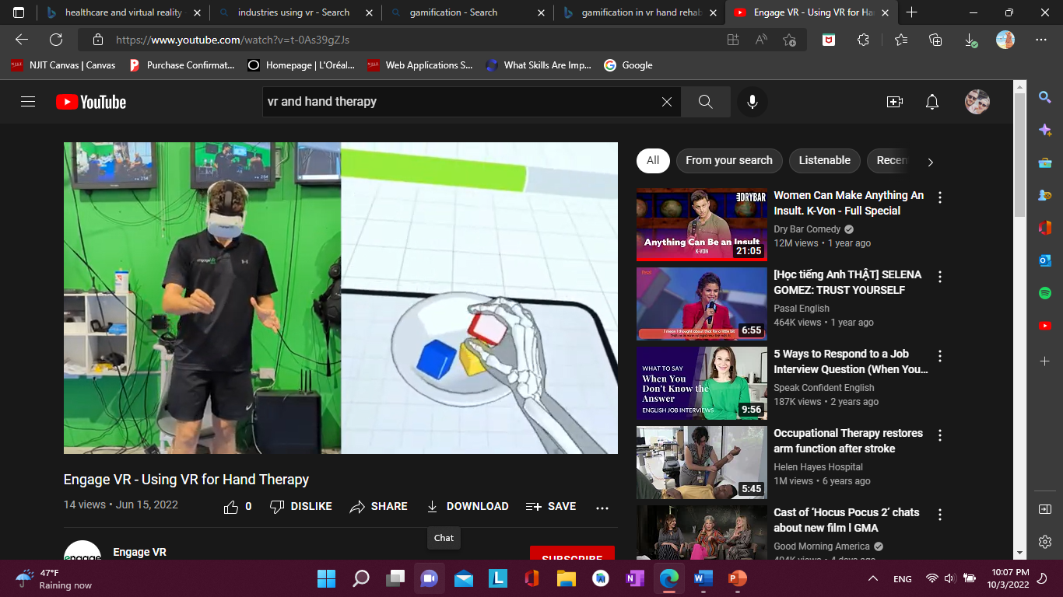
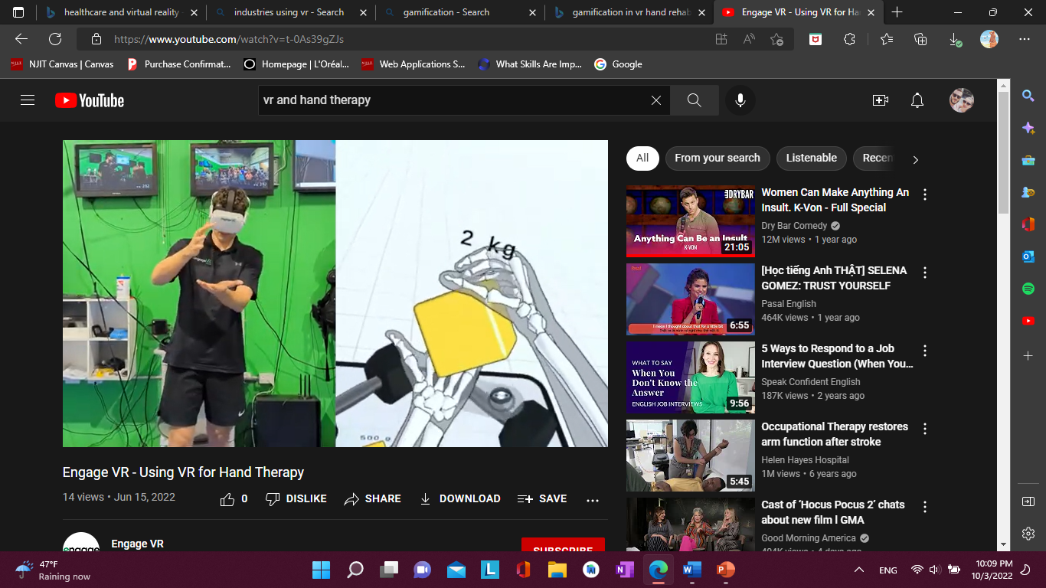
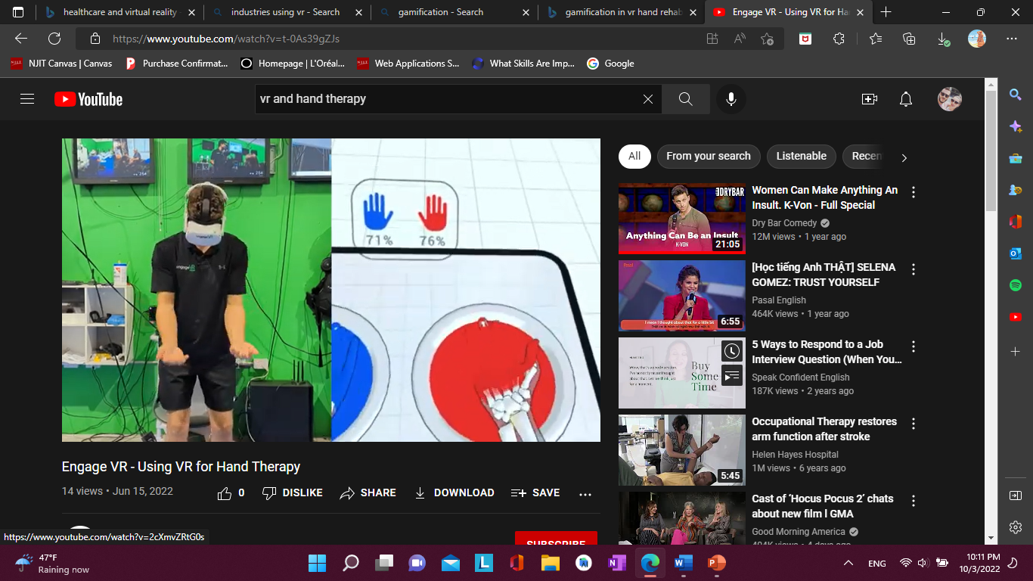
Engaging the patient in daily life tasks
1. Pinching an object
2. Squeezing an object
3. Grabbing or picking up an object
4. Extending your hands

Slide 11

How is virtual Reality helping hand therapy
Reduces the intensity of pain sensation during hand therapy
Motivates patients to perform therapeutic hand exercises
Makes hand therapy more engaging and fun.
Monitor how well patients are performing their hand exercises
Even assess the efficacy of the ongoing hand therapy treatments

Slide 12

Future of hand rehabilitation with vr
“Research has already started to back-up virtual reality as a successful treatment method.
In one study, stroke patients who underwent virtual reality rehab experienced more improvements in arm
and hand movement compared to conventional rehab after four weeks of therapy.” [3]
As technology evolves the VR experience in therapy will use Faster and better processors
Better graphics for an even better experience

Slide 13
References
[1] -What is Virtual Reality? - Virtual Reality Society (vrs.org.uk)
[2]- Gamification Definition & Meaning - Merriam-Webster
[3]- Virtual Reality (VR) Applications in Healthcare and Rehabilitation | tecla (gettecla.com)
Engage VR - Using VR for Hand Therapy – YouTube
How VR Therapy Can Help Reduce Chronic Pain (+Webinar) | XRHealth
Photos:
shorturl.at/bds27 [1]
https://smattes.com/article/47/sensorama [2]
healthcare and virtual reality - Bing images
Gamification of physical therapy in VR ° Ezra Ozery ° Design Tech - YouTube

